Slide 1
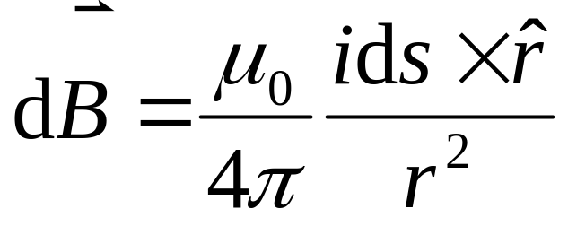
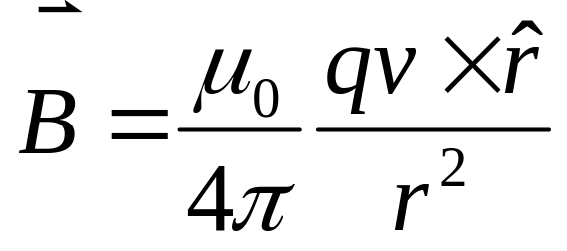
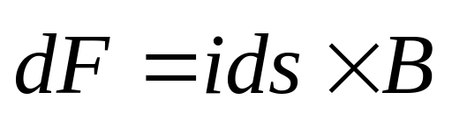
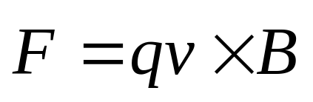
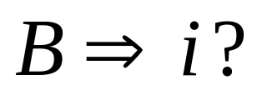
Biot-Savart law
Magnetic Field
Electrical Current
Faraday’s Law of Induction

Slide 2
Chapter 34 Faraday’s Law of Induction

Slide 3
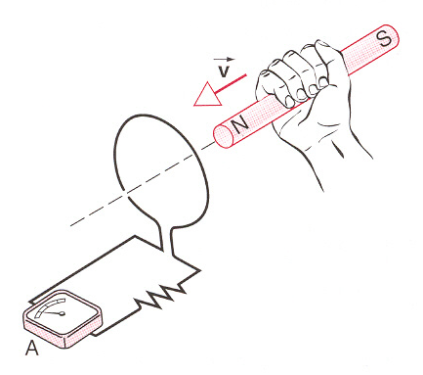
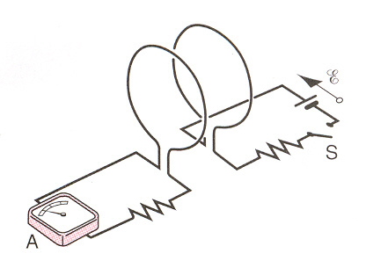
Faraday’s Experiments
The experiment about the induction:
The common feature: motion or change

Slide 4
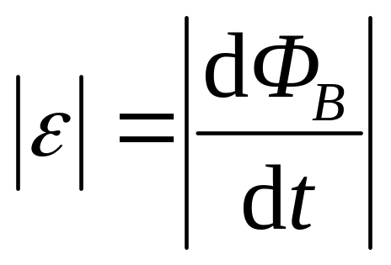
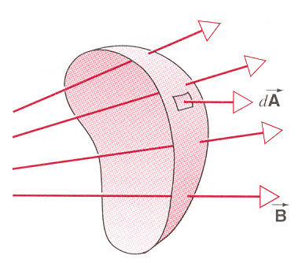
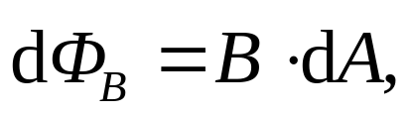
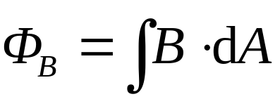
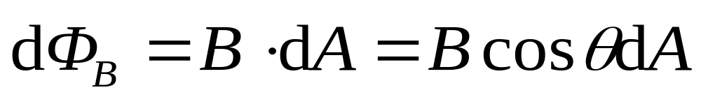
Faraday’s Law of Induction
EMF
Magnetic flux Φ_{B}
B can be changed.
θ can be changed.
dA can be changed.
EMF

Slide 5
Faraday’s law
induced current
Flux change
EMF
Lentz’ Law
Flux (cause)
Flux (result)
increase
induced current
decrease
decrease
increase

Slide 6
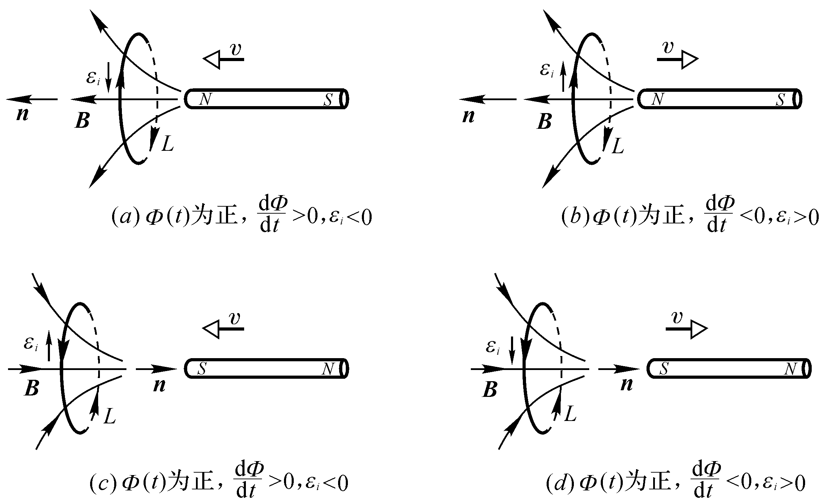


Slide 7
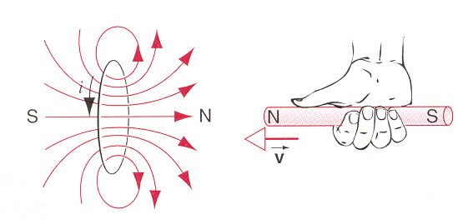
Conservation of energy considerations:
Mechanic energy
Electric energy

Slide 8
Conservation of energy considerations:
Electric energy
Electric energy

Slide 9
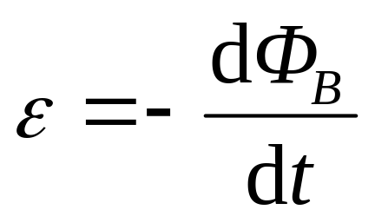
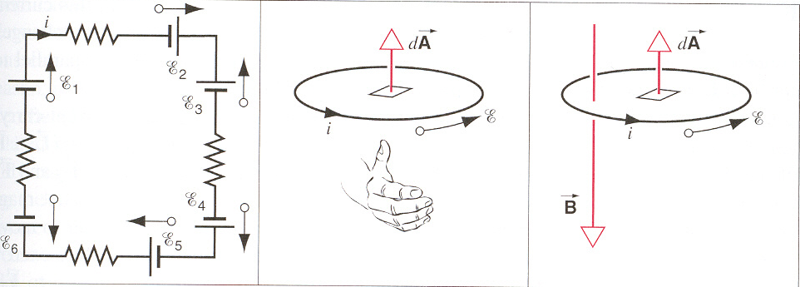
Signs in Faraday’s law
sign of ε sign of dA sign of flux Φ_{B}

Slide 10
Signs in Faraday’s law
sign of ε sign of dA sign of flux Φ_{B}

Slide 11
Signs in Faraday’s law
sign of ε sign of dA sign of flux Φ_{B}

Slide 12
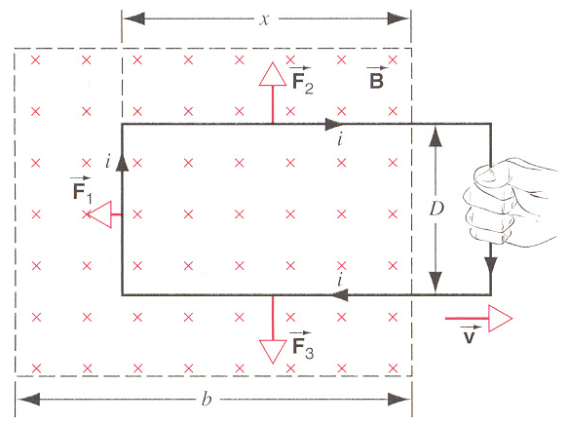
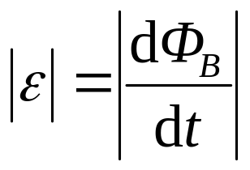
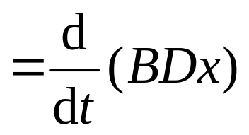

Motional EMF
From Lenz’ law, the induced current is clockwise.
the EMF is clockwise.
the induced current is clockwise.

Slide 13
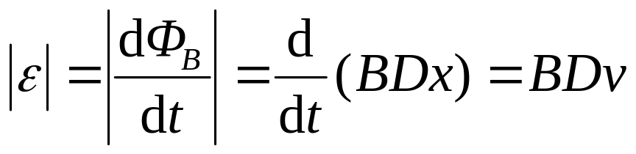
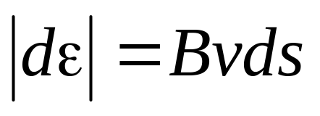
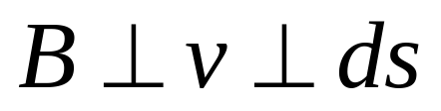
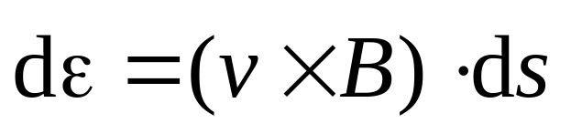
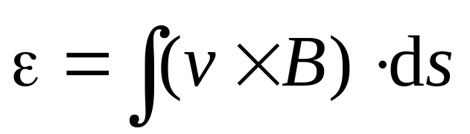
Motional EMF
In general,

Slide 14
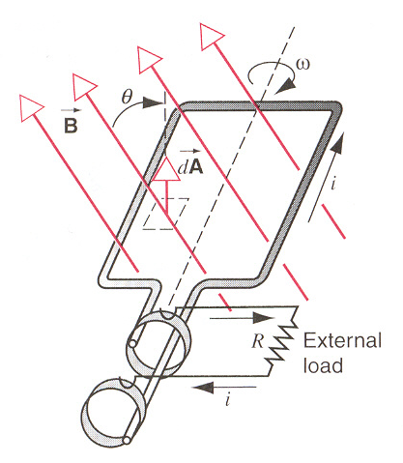

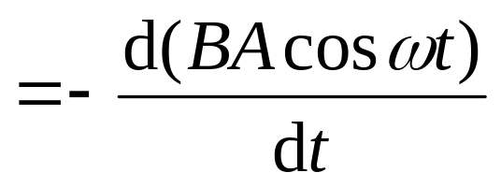

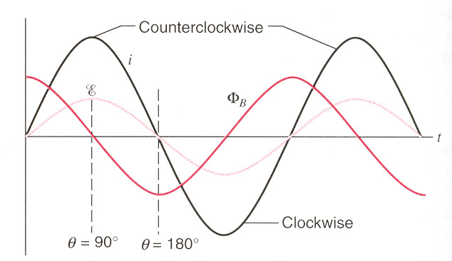
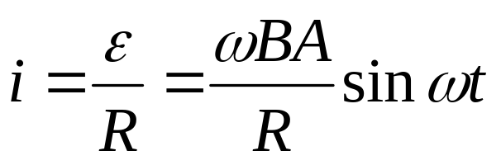
Generators and Motors
Generator is a device for converting mechanical work (or other) into electrical work in the load.
alternating current (AC)

Slide 15
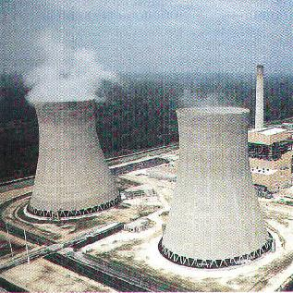
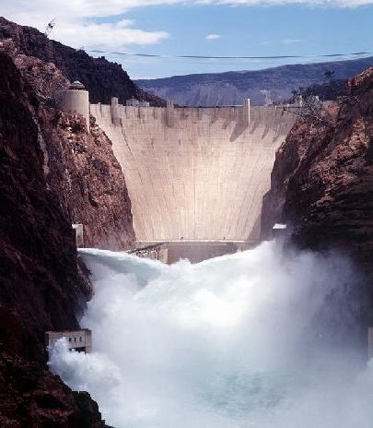
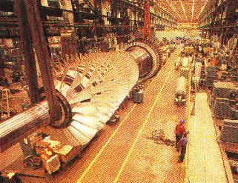
chemical energy
electric energy
mechanical energy

Slide 16
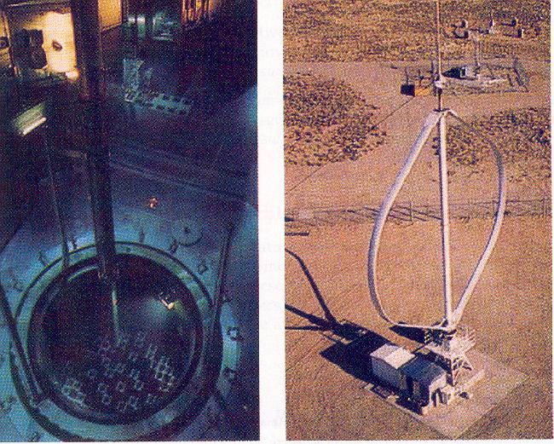
atomic energy
electric energy
mechanical energy
Nuclear reactor at Tihange , Belgium
Wind-powered electric generator at Sandia National laboratory.

Slide 17
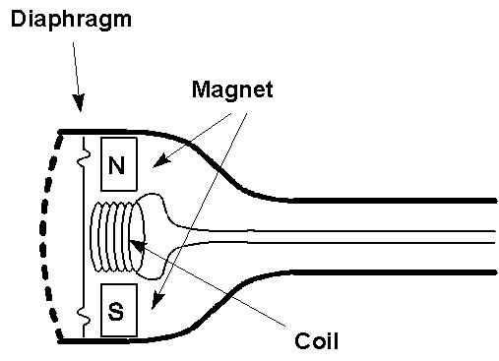
“Dynamic” Microphones
  (E.g., some telephones)
        Sound
  → oscillating pressure waves
  → oscillating [diaphragm + coil]
  → oscillating magnetic flux
  → oscillating induced emf
  → oscillating current in wire
  after amplification → Sound

Slide 18
Faraday’s law
induced current
Flux change
EMF
Lentz’ Law
Flux (cause)
Flux (result)
increase
induced current
decrease
decrease
increase

Slide 19
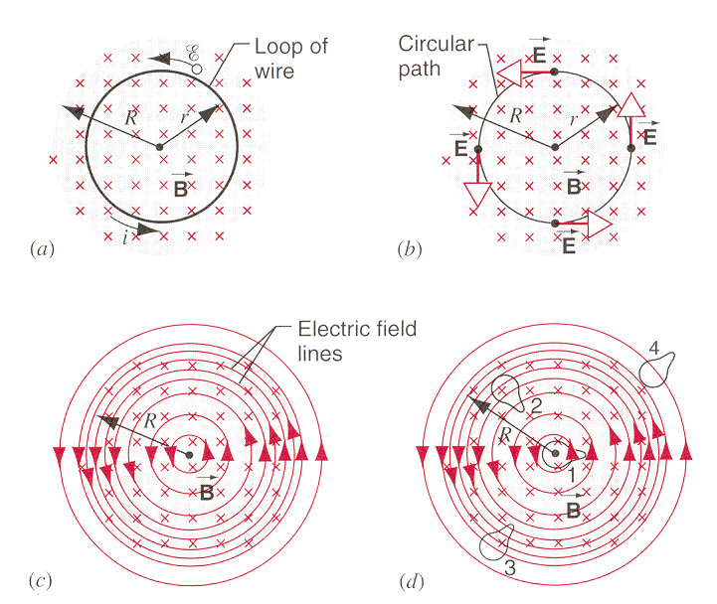
Induced Electric Field
How accelerate the charges to move?
Induced electric fields

Slide 20
Induced Electric Field
In conductor
In Space
Changing magnetic field
Electrical Field
Electrical Current
How accelerate the charges to move?
Induced electric fields.

Slide 21
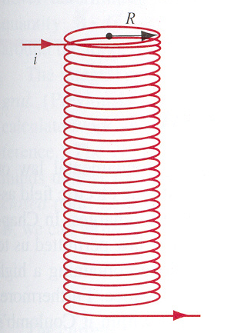
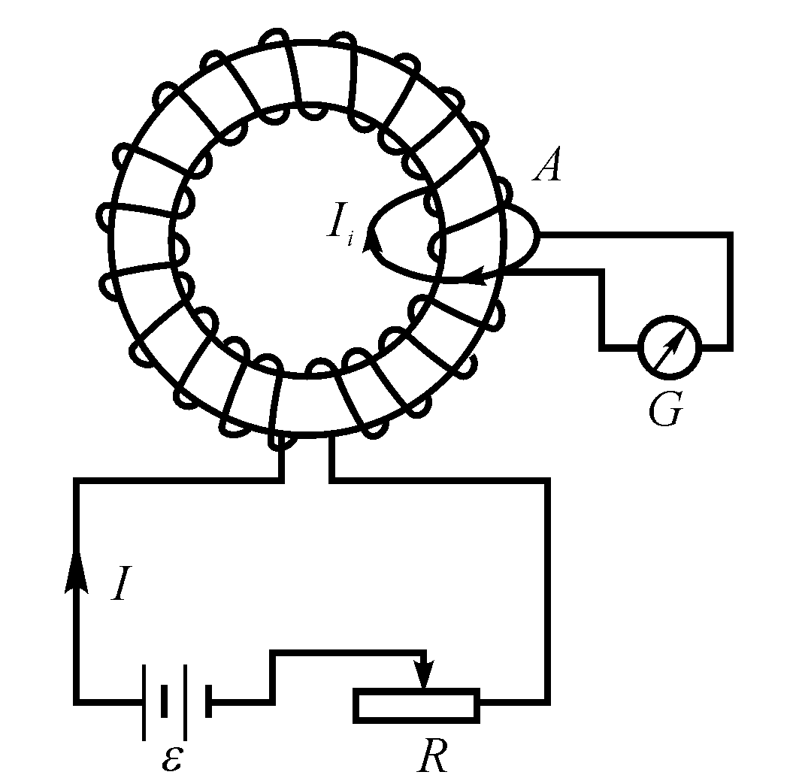
Induced Electric Field

Slide 22

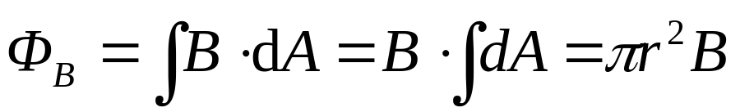
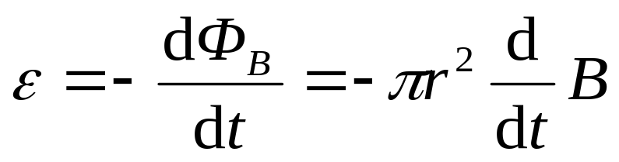
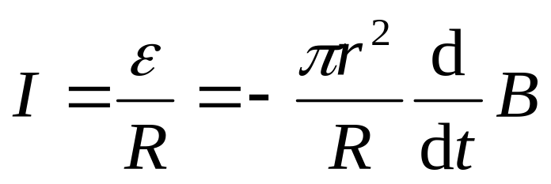
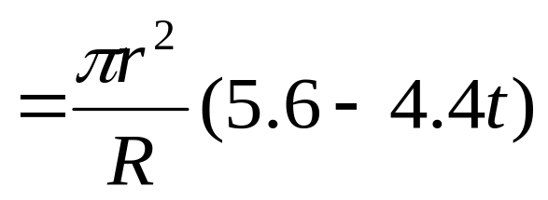
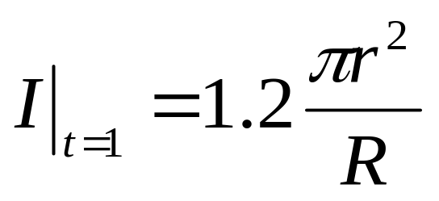
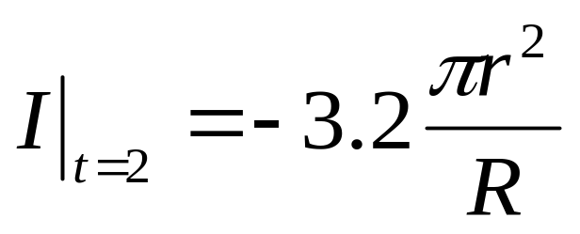
Example
r, R (resistance) are known, B_{z}=-4.0-5.6t+2.2t². Find induced current in the loop at t=1s and t=2s.

Slide 23

Example
r, R (resistance) are known, B_{z}=-4.0-5.6t+2.2t². Find induced current in the loop at t=1s and t=2s.

Slide 24
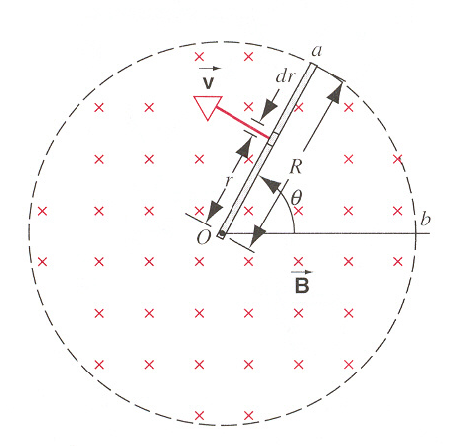
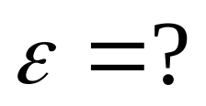
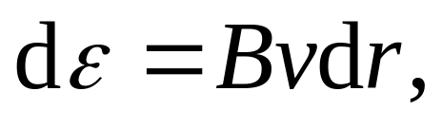
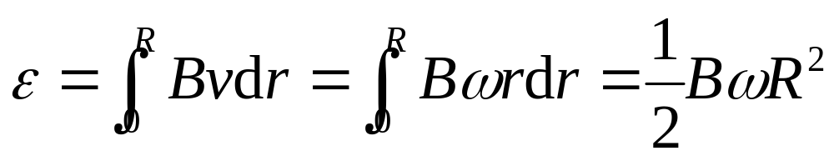
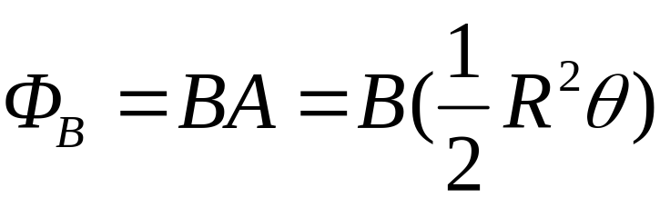
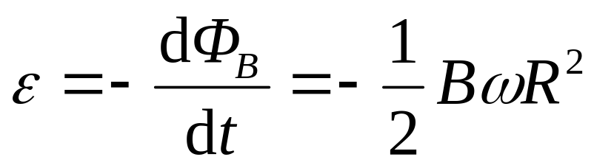
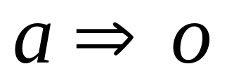
Example
suppose oab is a loop,
What is the direction of induced EMF?

Slide 25
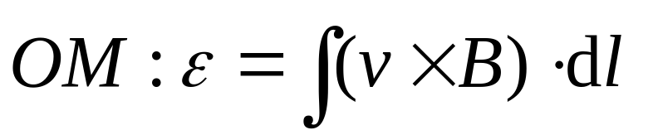






Example: As shown, find the emf ε when the rod (length L) in location OM, and ON.
M
ω
dl
l
i
r₀
o
N
r
Direction of EMF ?

Slide 26
Exercises
P796 23, 24, 27
Problems
P798 5, 9

Slide 27
Induced Electric Field
In conductor
In Space
Changing magnetic field
Electrical Field
Electrical Current

Slide 28





Induced electric fields
In the closed loop, the work done on the charge by the induced electric field is
The induced emf in the loop is
Induced Electric Fields

Slide 29



Induced electric fields
In the closed loop, the work done on the charge by the induced electric field is
The induced emf in the loop is
Electrostatics Field
Induced Electric Fields

Slide 30






Calculation of Induced Electric Field
For the cylindrical field distribution (radius R), dB/dt>0,

Slide 31


The betatron
Betatron produces a pulsed rather than a continuous beam.

Slide 32


Induction furnace
Change current
EMF
current
Electric energy
Heat

Slide 33

Magnetic breaking
s

Slide 34
Magnetic breaking
Damping Oscillation
N

Slide 35


STM
Magnetic Damping

Slide 36


Eddy currents
Electric energy heat energy

Slide 37

Eddy currents
Electric energy heat energy
Transformer
Materials are laminated.

Slide 38







Induction and Relative Motion
In S frame
N´

Slide 39



Induction and Relative Motion
In S frame
N´
In S’ frame

Slide 40











Example
when r < R,
When r > R,

Slide 41














Example

Slide 42







Example

Slide 43












Example
As shown, R, L, h, dB/dt are known, find emf in the rod.
y
b
E_{i}
B
r
o
θ
h
L
x
R
a
Direction of emf a→b

Slide 44









Example
As shown, R, L, h, dB/dt are known, find emf in the rod.
y
b
Loop “a-c-b-a”
B
c
o
h
L
x
R
a
Direction of emf a→b
Direction of emf a→b

Slide 45





Example
As shown, R, L, h, dB/dt are known, find emf in the rod.
y
b
Loop “a-o-b-a”
B
c
o
h
L
x
R
a
Direction of emf a→b

Slide 46








Example
b
EMF of ab ?
B
o
h
L
x
R
a

Slide 47





Example
b
EMF of ab ?
B
o
h
L
x
R
a

Slide 48
Exercises
P797 29, 31,
Problems
P799 10, 11, 14

